Slide 1

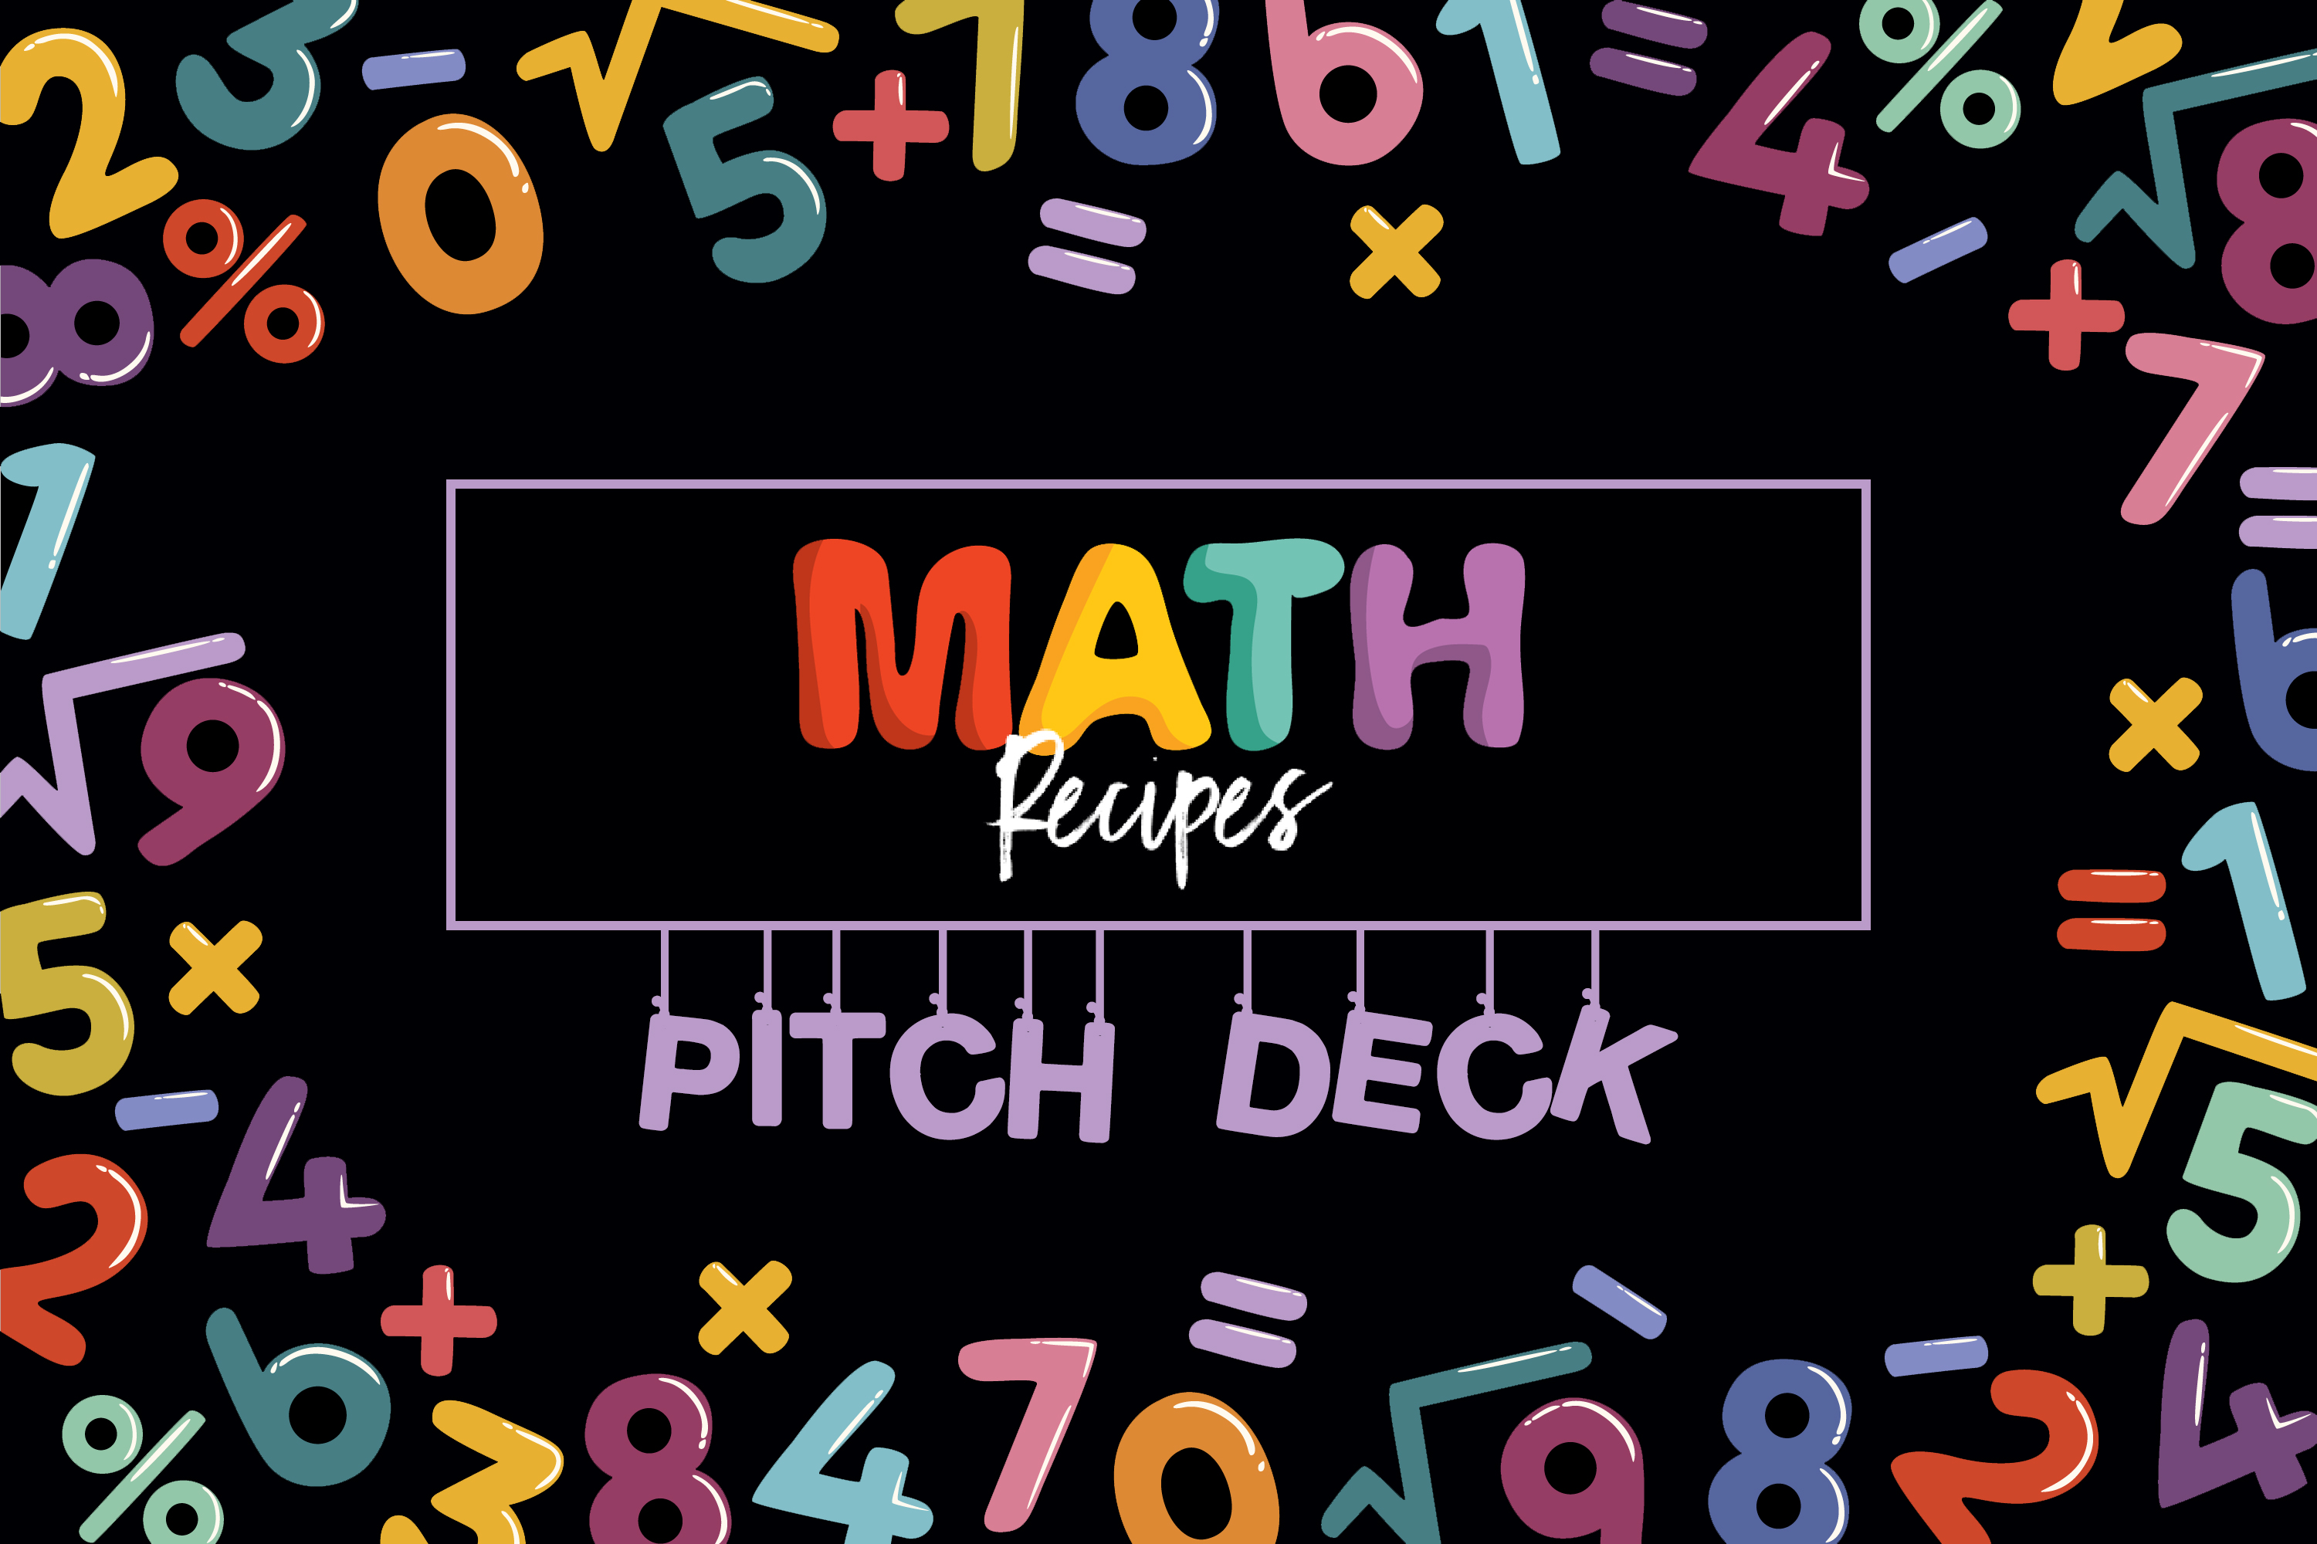

Slide 2

Group pARTNERS
Bakhtawar Shafqat (bs03702)
Laiba Fatima Khan (lk04067)

Slide 3
MATH RECIPES DISCOVER THE FUN FLAVOURS OF MATH
Math concepts are not confusing anymore
Learn math through story telling and animations
Can be accessed from anywhere, anytime

Slide 4

NATURE OF PROBLEM BEING SOLVED
We know many students struggle with Math because
a. Classroom teaching doesn't make sense to them or not interesting enough
b. They learn but forget difficult concepts later
Moreover, The Parents
a. Can't afford expensive tutors other than school education
b. Don't have time or skill to teach kids at home

Slide 5
NATURE OF PROBLEM BEING SOLVED
Math Recipes caters not only an average student but aims to cater the needs of all children with problems such as Dyscalculia which causes students to struggle with formulas, shapes, and number-related concepts, making it difficult for them to understand and process math problems. Students with math anxiety, students that lack proper math foundation or generally any child who has fallen behind in the basic concepts and was forced to move on to advanced levels before he/she was ready.

Slide 6
INTERESTED MARKET
Our primary market segment is Primary level school going students [grade 1 to 5] and their parents.
These children find it tricky to understand Mathematics concepts, or they just feel overwhelmed. Due to not understanding hard concepts, they start to dislike math. Moreover, we want to help the parents who want to assist their children with math at home but lack proper skills or resources to do so.

Slide 7
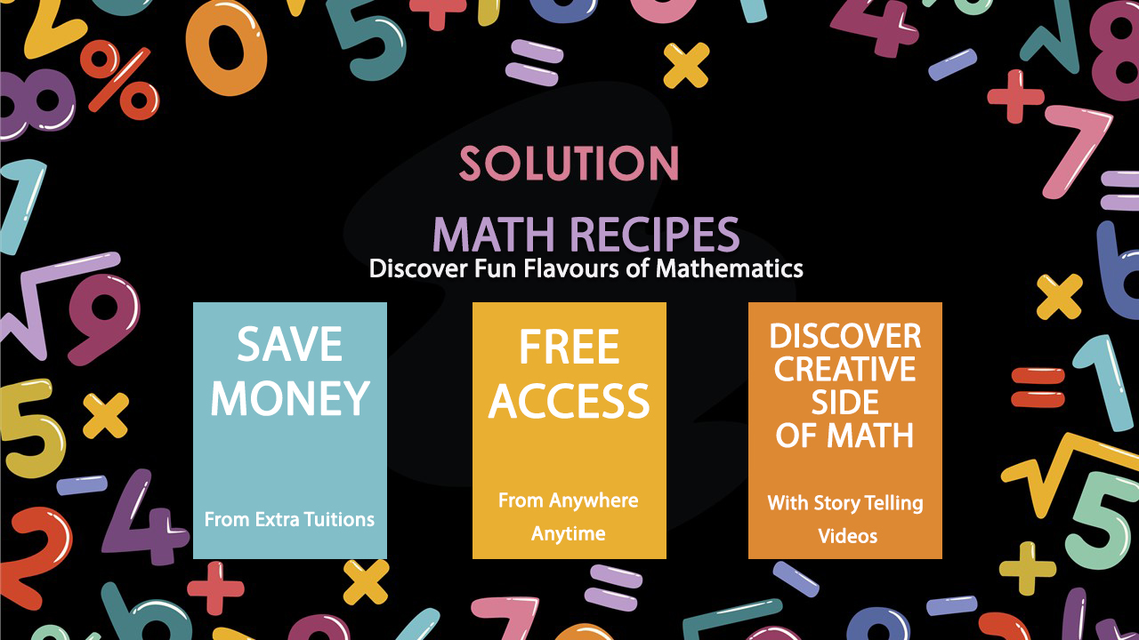

Slide 8
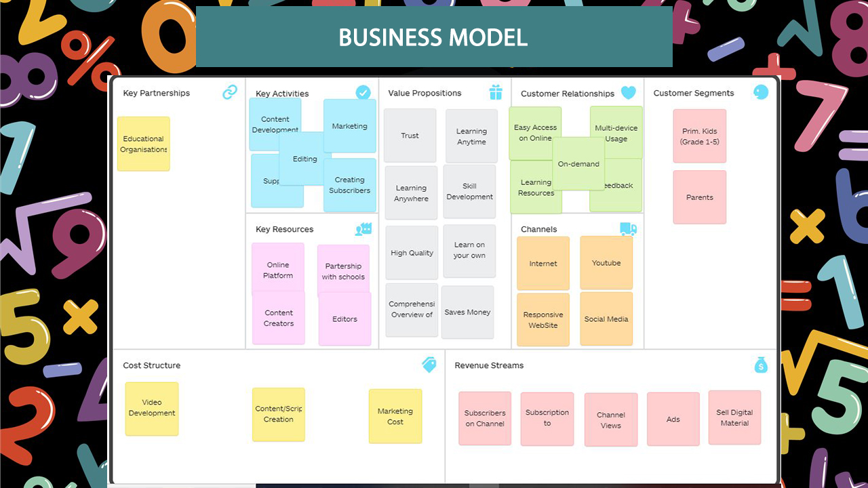

Slide 9
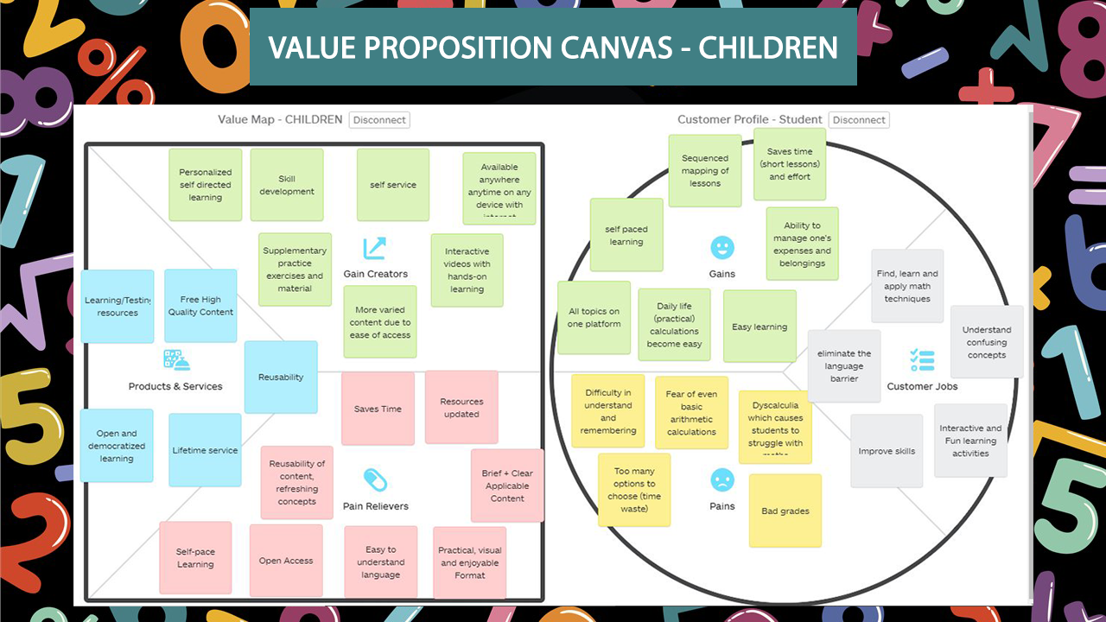

Slide 10
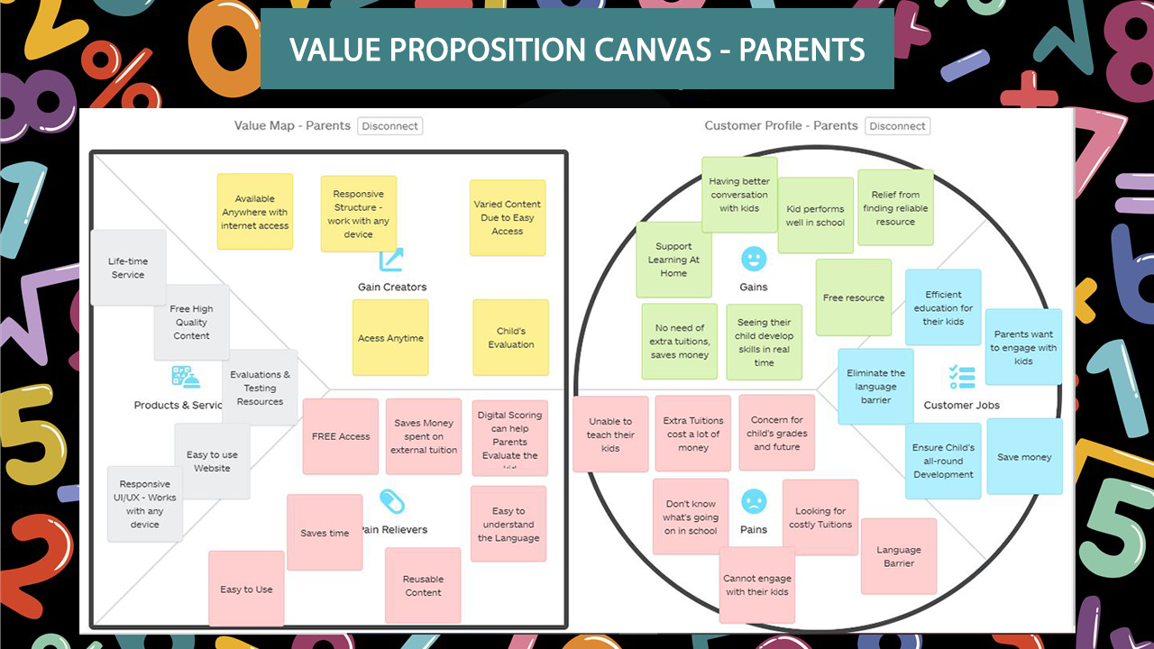

Slide 11
ASSUMPTIONS: Problem
Kids usually find Math boring and hard to understand. It is also highly likely to forget math concepts. We observed that this happens because:
Classroom teaching methods are not interactive enough and do not engage every student.
Parents are busy, or they don’t know how to teach math.
Kids can’t learn math from books by themselves as Textbook language is hard to understand
Extra tuitions are hard to find, cost a lot of money and parents usually can’t afford.
Most online lessons use language that kids cannot relate with.
In this pandemic, kids are not keeping in touch with studies.

Slide 12
ASSUMPTIONS: Solution
Math Recipes aims to improve students’ Mathematics learning experience, keeping interests of young kids in consideration. We observed that:
Kids like stories and cartoon animations.
People remember childhood stories and their message.
Kids prefer colorful over two-tone (videos vs black/whiteboard teaching)
Kids spend some time on screen daily (so our service is not added harm just a few minutes out of usual use)
Hence, we concluded that making learning fun, and not-really-study, is the only way for successful teaching.

Slide 13
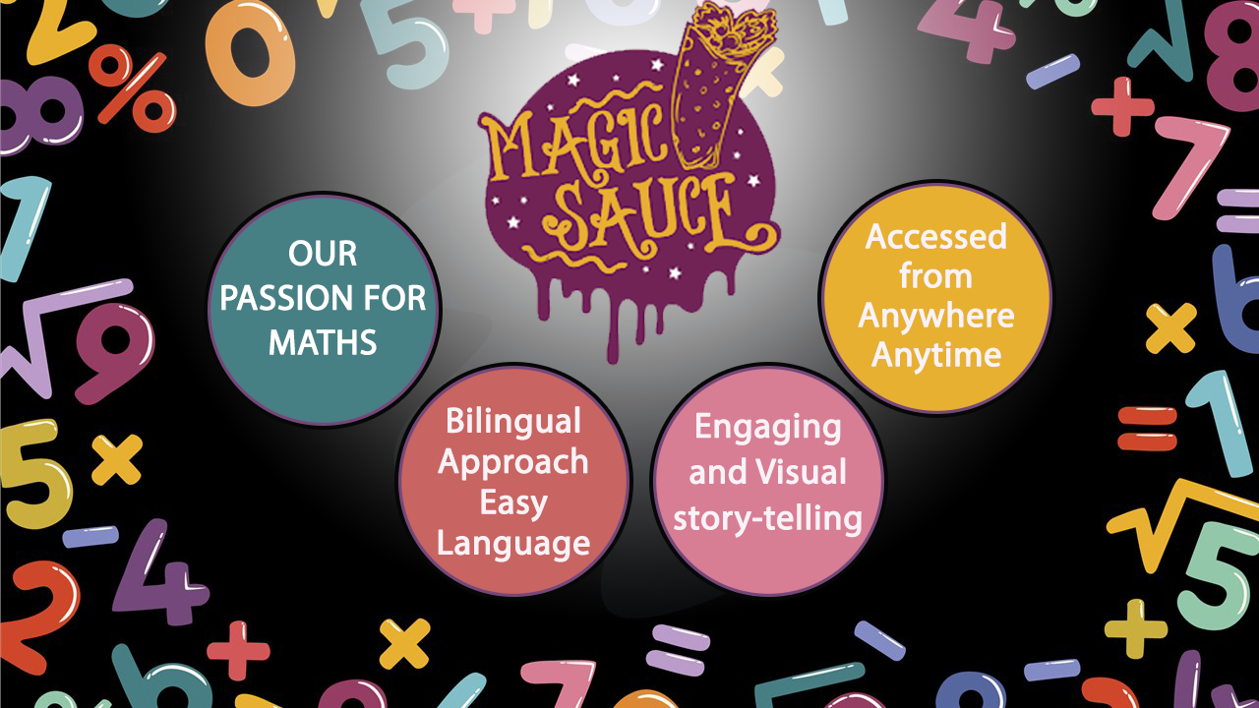

Slide 14
THANK YOU!

